Slide 1
Document Scanner Using Classical Image Processing and OCR
Made By: Ahmed Gaber
SUPERVISED BY: Dr. Tarek Ghonemy

Slide 2
Document Scanner
A complete document scanning system that:
Captures document images
Processes images to enhance quality
Detects document boundaries
Corrects perspective distortion
Extracts text using OCR
Key Technologies Used
OpenCV - Image processing
NumPy - Numerical operations
Tesseract OCR - Text recognition
Matplotlib - Visualization

Slide 3
Data set
Categories and Characteristics:
Advertisements: Images of promotional materials featuring mixed text, graphics, and unconventional layouts.
Emails: Scanned correspondence, including structured headers, signatures, and body content.
Forms: Predefined templates with structured data fields, such as application forms or invoices.
Letters: Personal or formal correspondence, showcasing handwritten and printed styles.
Memos: Internal business communications with concise text and headers.
News: Scanned newspaper clippings and articles, combining columns, images, and headlines.
Notes: Informal handwritten or typed notes, often featuring irregular spacing and formatting.
Reports: Documents with structured sections, tables, and graphs, such as financial or project reports.
Resumes: Personal profiles with a mix of structured text fields, tabular data, and occasional creative designs.
Scientific Papers: Complex layouts featuring dense text, mathematical equations, tables, and diagrams.

Slide 4
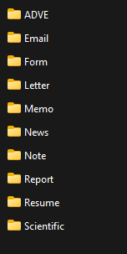
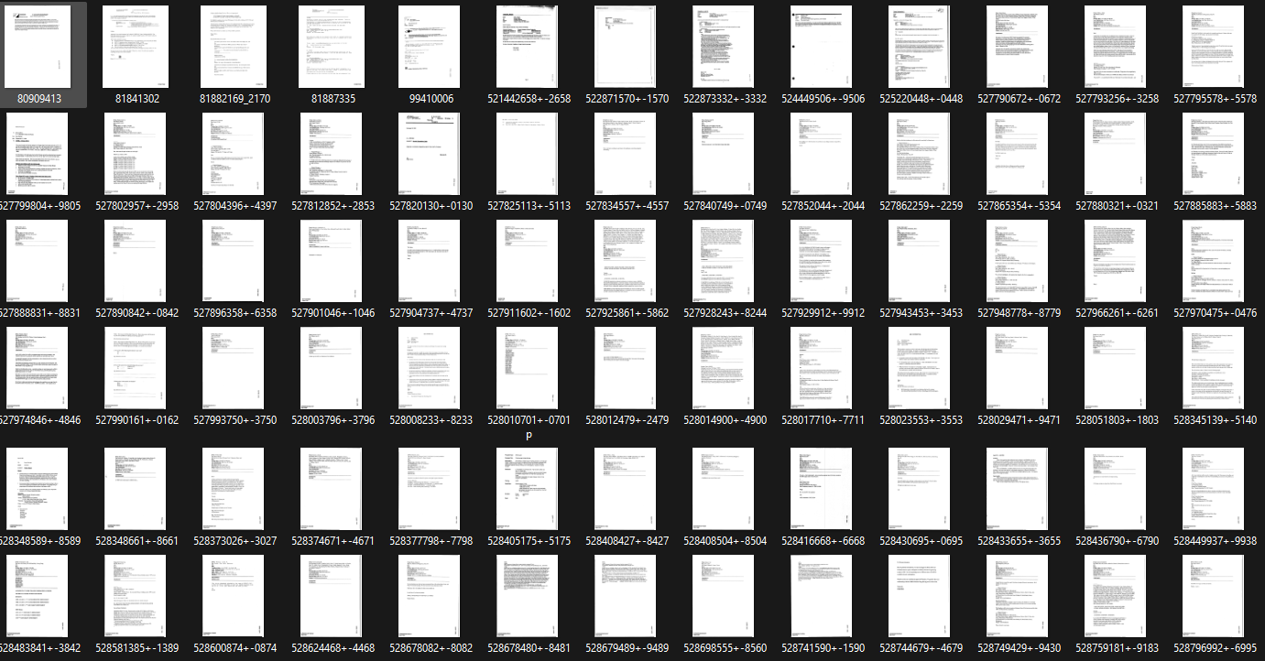
Data set

Slide 5
Complete Pipeline 8-Step Process
The Image Loading → Read input image
Grayscale Conversion → Simplify processing
Noise Removal → Clean image
Edge Detection → Find boundaries
Morphological Operations → Enhance features
Contour Detection → Locate document
Perspective Correction → Fix distortion
OCR Processing → Extract text

Slide 6
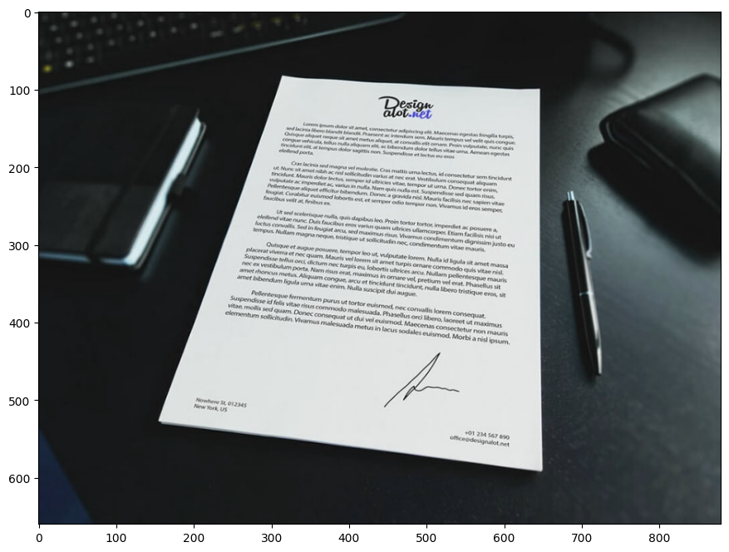
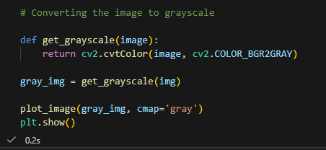
Step 1 - Image Loading & Color Conversion

Slide 7
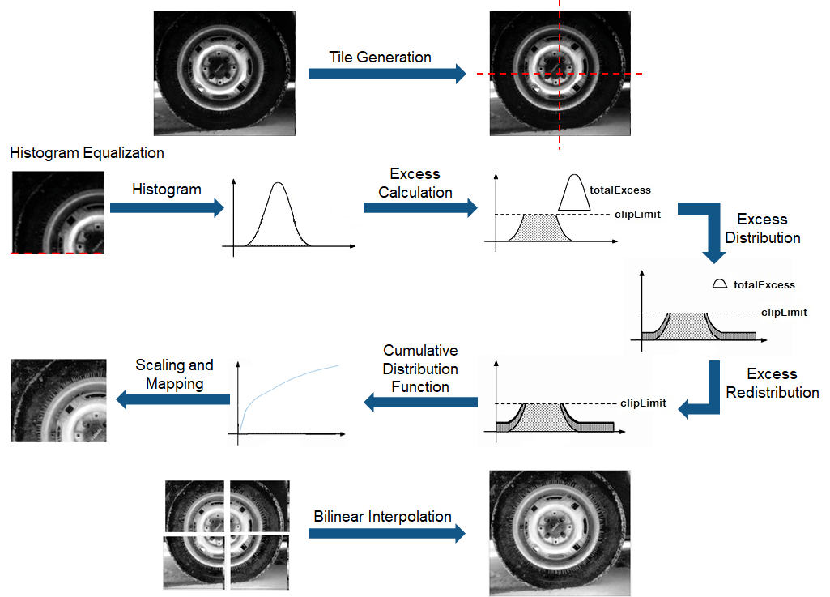

Step2- CLAHE (Contrast Limited Adaptive Histogram Equalization):
Advanced image processing technique used to enhance contrast in digital images.
Tiles in CLAHE are:
Local processing units that allow adaptive enhancement
Small image segments processed independently
Blended together to avoid visible boundaries
Configurable based on image size and enhancement needs

Slide 8
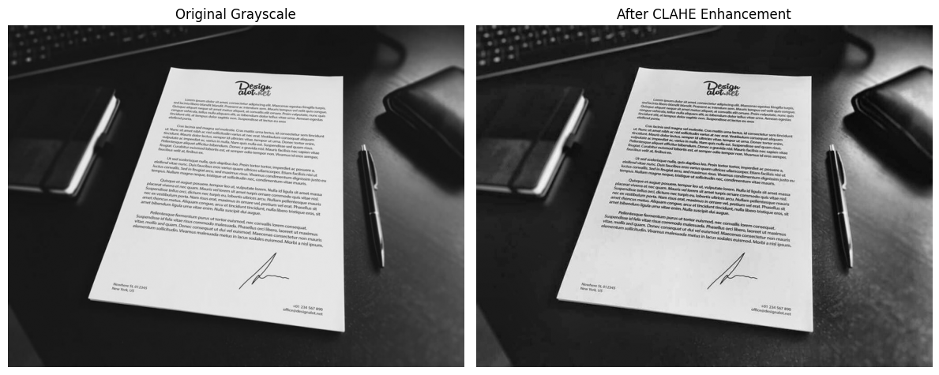
Step2- CLAHE (Contrast Limited Adaptive Histogram Equalization):

Slide 9
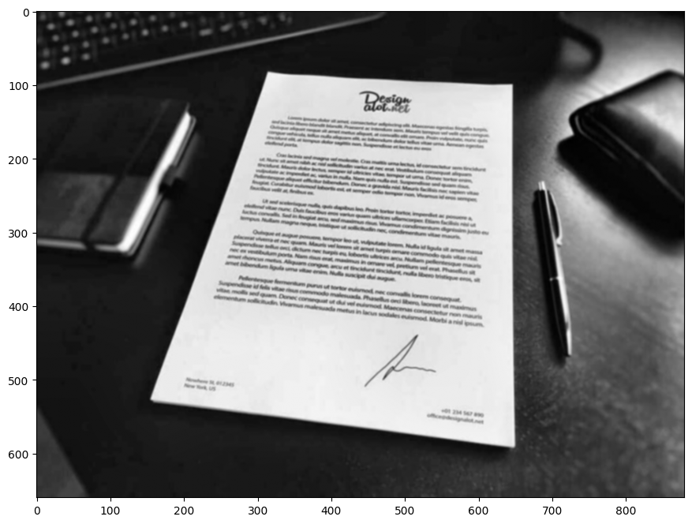

Step 3 - Noise Removal (Gaussian Blur)
The Problem
Images contain noise (random pixel variations)
Noise interferes with edge detection
Caused by camera sensors, lighting, compression
Solution: Gaussian Blur (smoothing filter)
How it works: Applies weighted average using Gaussian distribution
Kernel size (5,5): Defines the area for averaging
Sigma (1): Controls the spread of the Gaussian curve

Slide 10
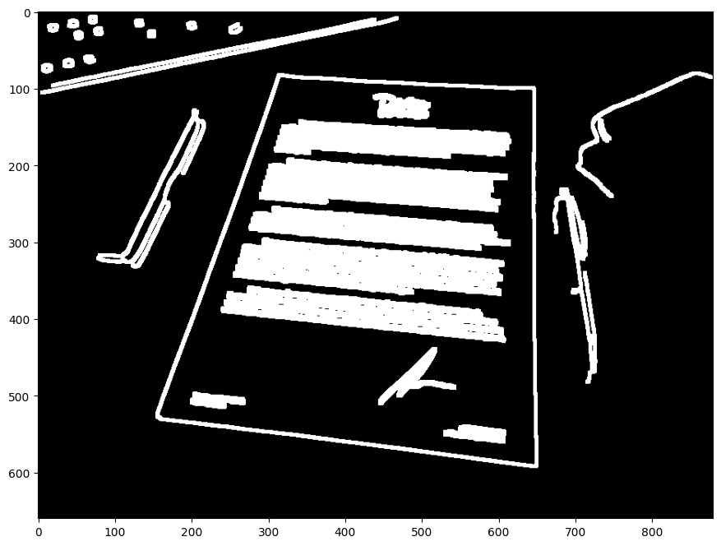
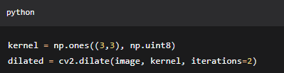
Step 4 - Morphological Operations
The Problem
Binary images may have:
Broken edges (disconnected lines)
Small holes (gaps in contours)
Noise artifacts (isolated pixels)
Dilation:
Expands white regions
Connects broken edges
Fills small gaps

Slide 11

Step 4 - Morphological Operations
Erode:
Shrinks white regions
Removes small noise
Separates connected objects

Slide 12

Step 4 - Edge Detection (Canny Algorithm)
What are Edges?
Edges: Sudden changes in pixel intensity
Important: Document boundaries are edges!
Challenge: Distinguish real edges from noise
Canny Edge Detection: 4-Step Process
Noise Reduction (already done with Gaussian blur)
Gradient Calculation - Finds intensity changes
Non-Maximum Suppression - Thins edges
Hysteresis Thresholding - Final edge selection
Threshold Values Explained
Low threshold (100): Minimum intensity for edges
High threshold (200): Strong edges definitely kept
Hysteresis: Edges between thresholds are kept if connected to strong edges
Why Canny? Produces thin, connected edges with minimal noise!

Slide 13
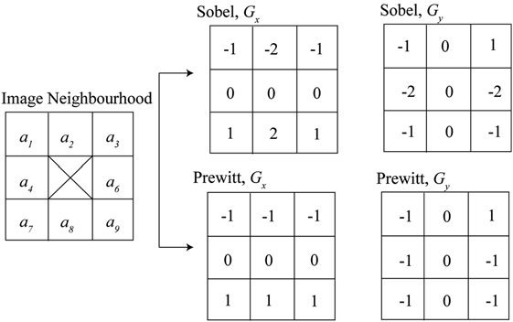
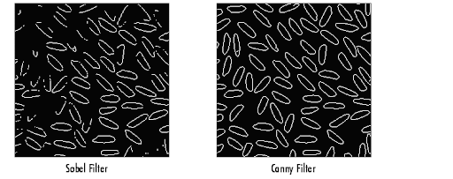
Step4- Canny edge detection (Finding Intensity Gradients)
Content: Detect areas of rapid intensity change. Calculate both the strength and direction of the change at each pixel.
How? Apply Sobel (or Prewitt) filters in the horizontal (Gx) and vertical (Gy) directions. Visual:

Slide 14
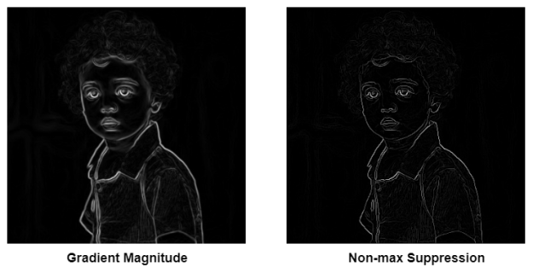
Canny edge detection (Non-Maximum Suppression)
Content: The gradient image has thick edges. We want thin, precise lines.
How? For each pixel, we check along the gradient direction. We keep the pixel only if it is the local maximum along that direction; otherwise, we suppress it (set to zero).

Slide 15
Canny edge detection (Hysteresis Thresholding)
Content: Decide which edges are real and which are due to noise. How?
Double Threshold: We set two levels:
High Threshold: Pixels stronger than this are "strong edges" (keep).
Low Threshold: Pixels weaker than this are discarded.
Pixels in between are "weak edges" (maybe keep).
Hysteresis Tracking: A weak edge is kept only if it is connected to a strong edge. This links broken segments.

Slide 16
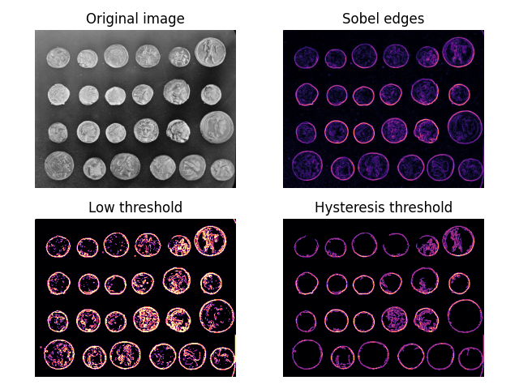
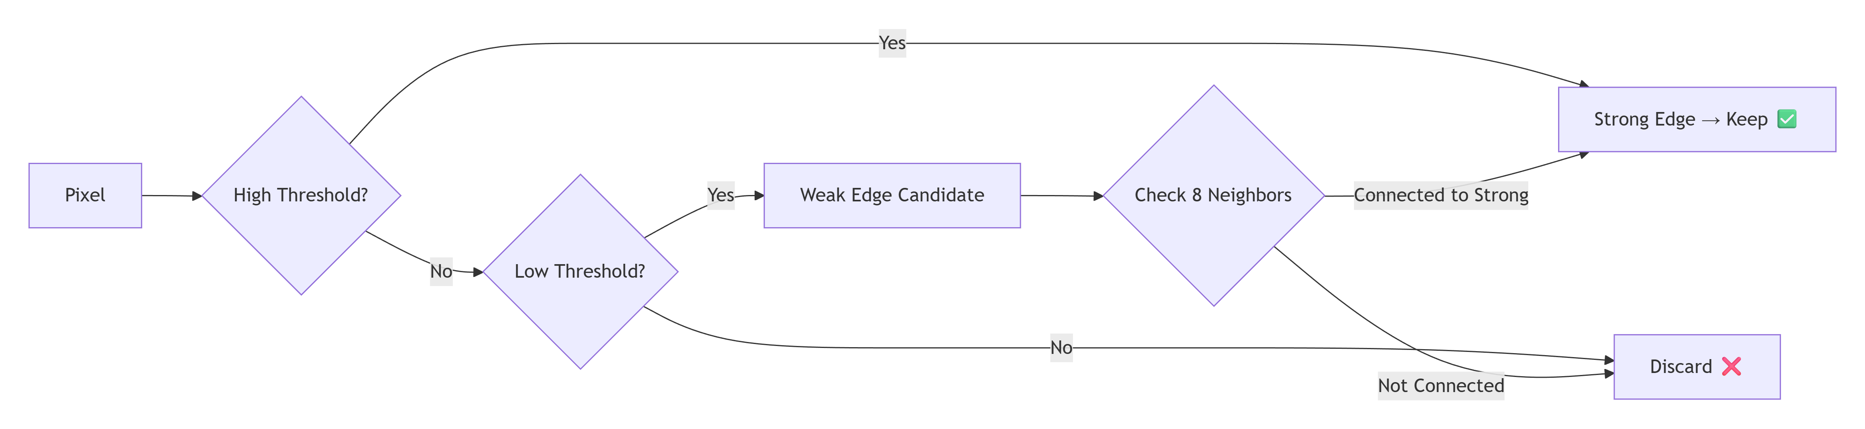
Canny edge detection (Hysteresis Thresholding)

Slide 17
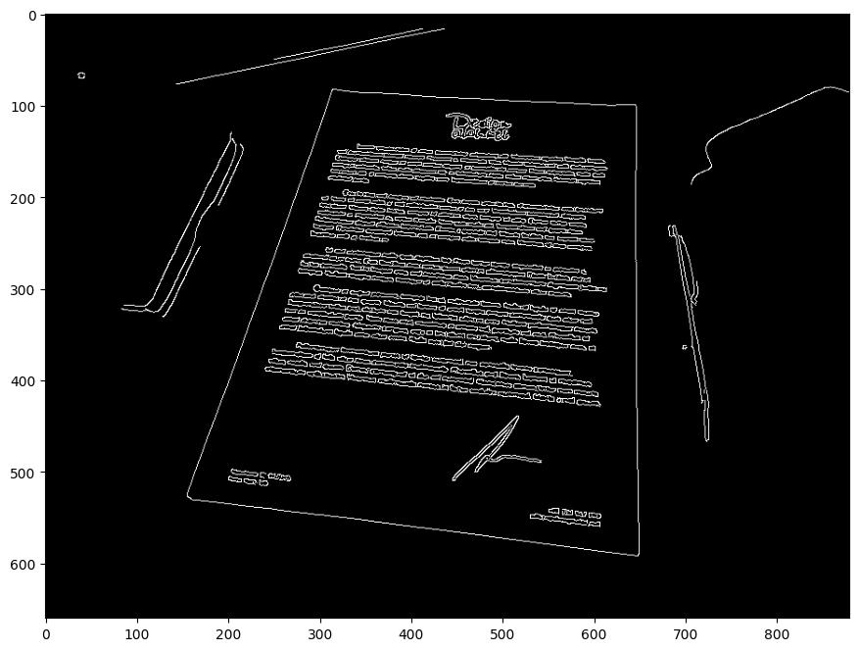
Step 4 - Edge Detection (Canny Algorithm)

Slide 18
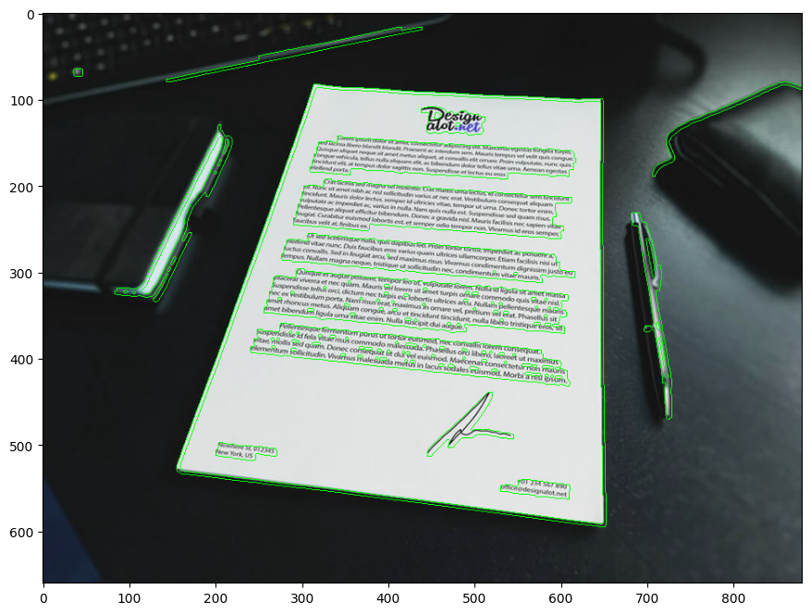

Step 6 - Contour Detection
What are Contours?
Closed curves joining continuous points
Boundaries of objects in binary images
Hierarchical relationships between contours

Slide 19
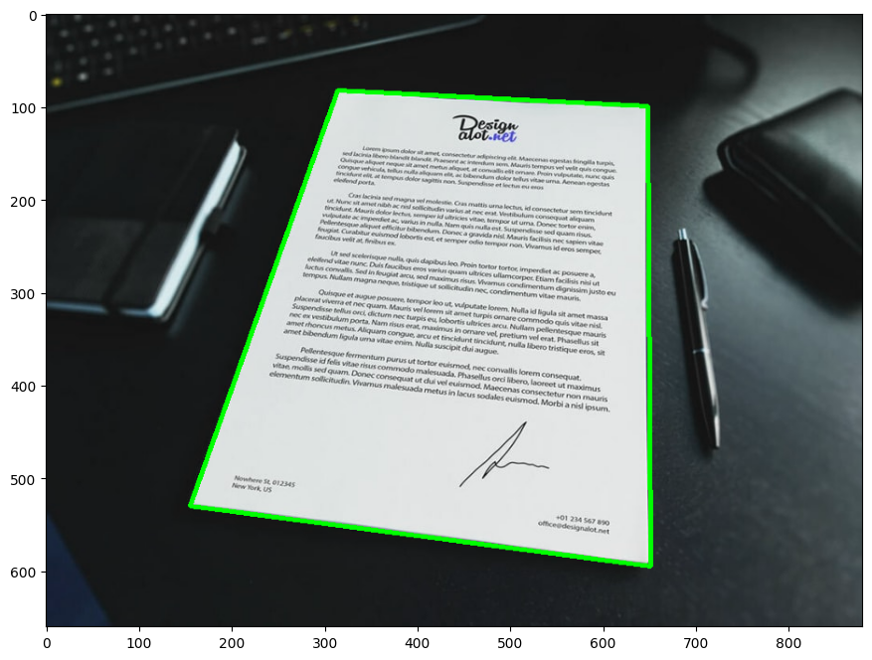
Step 6 - Contour Detection
Document Selection Logic
Find all contours
Sort by area (largest first)
Approximate shape
Select first quadrilateral (4 points = likely document)
Smart approach: Assumes document is the largest quadrilateral!

Slide 20
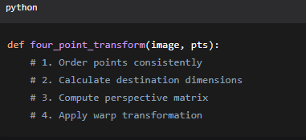
Step 7 - Perspective Correction
The Challenge
Perspective distortion from angled photos
Keystone effect - converging lines
Document appears trapezoidal, not rectangular

Slide 21
Step 7 - Perspective Correction
The Math Behind It
Order Points: TL, TR, BR, BL
Calculate Dimensions:
width = max(distance(TR, TL), distance(BR, BL))
height = max(distance(BR, TR), distance(BL, TL))
Perspective Matrix: 3×3 transformation matrix
Warping: Apply matrix to all pixels

Slide 22
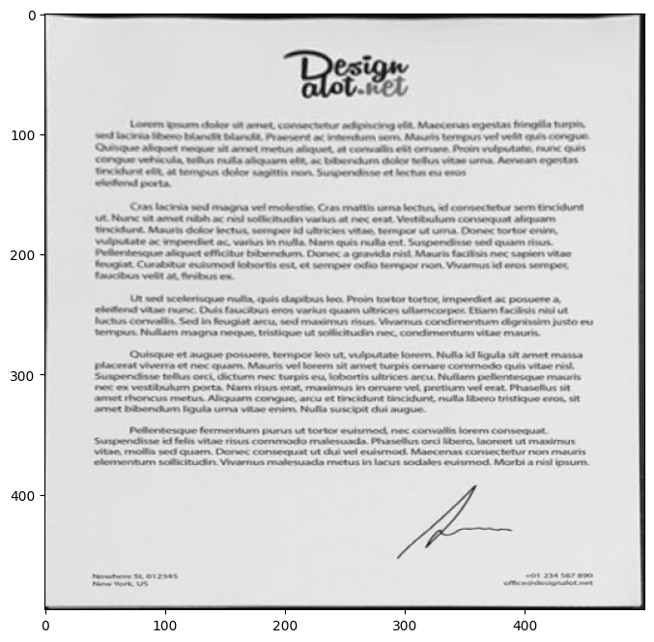
Step 7 - Perspective Correction
Visual Transformation
Original (Distorted) | Corrected (Top-Down)
Angled view | Straight view
Trapezoidal shape | Rectangular shape
Size varies | Uniform scaling
Result: Perfect rectangular document ready for OCR!

Slide 23
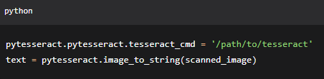
Step 8 - OCR with Tesseract
Tesseract OCR Engine
Open-source OCR engine by Google
Supports 100+ languages
Trained on various fonts and styles
Tesseract's Internal Pipeline
Page Layout Analysis - Identifies text blocks
Line Detection - Finds text lines
Word Segmentation - Separates words
Character Recognition - Identifies characters
Language Modeling - Contextual correction

Slide 24
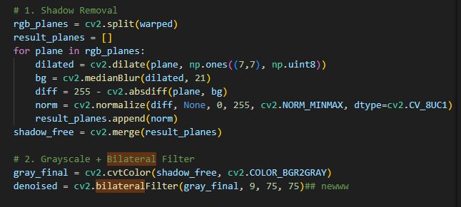
Contribution
1. Shadow Removal and Lighting Correction
(Advanced): Uses Morphological Transformation (dilation and median blur) on individual RGB channels to estimate the background lighting. It then subtracts that background to effectively "erase" shadows.
(Basic): Does nothing to remove shadows. It assumes the lighting is uniform, which often results in large black blobs in the OCR output if a shadow is present.
2. Denoising and Edge Preservation
(Advanced): Implements a Bilateral Filter. This is crucial for handwriting because it removes "noise" (graininess) while keeping the edges of the pen strokes sharp.
(Basic): Uses a standard Gaussian Blur. This is a "blind" blur that can smudge thin handwriting, making it harder for Tesseract to read.
3. Contrast Enhancement
(Advanced): Adds CLAHE (Contrast Limited Adaptive Histogram Equalization). This "pops" faint text by increasing contrast in small local regions of the image.
(Basic): Does not enhance contrast; it moves straight from grayscale to thresholding.

Slide 25
OCR Measurements
Evaluating Optical Character Recognition Performance
Word Accuracy & Word Error Rate (WER)

Slide 26
Why Measure OCR Accuracy?
- Quantify OCR performance objectively
- Compare preprocessing techniques
- Validate research results
Ground Truth Text:Used as baseline for comparison
Word Accuracy
Word Error Rate (WER) Accuracy

Slide 27
Word Accuracy
Measures how many words are correctly recognized
Formula:
Word Accuracy = Correct Words / Total Ground Truth Words
Word Error Rate (WER)
Formula:
WER = (S + D + I) / N
Lower WER = Better OCR performance
S = Substitutions
D = Deletions
I = Insertions
N = Number of words in ground truth

Slide 28
Word error rate
WER answers:
“How many edits are needed to convert OCR output into the correct text?”
The Three Types of Errors in WER:
Substitution (S):A wrong word replaces a correct one.
Ground Truth: this is a document
OCR Output: this is the document
We have 1 substitution
Deletion (D): A word is missing in OCR output.
Ground Truth: this is a document
OCR Output: this is document
Insertion (I): An extra word appears in OCR output.
Ground Truth: this is a document
OCR Output: this is a scanned document
Note: Text Normalization will be needed:
- Convert to lowercase
- Remove punctuation
- Normalize whitespace

Slide 29

Testing
Our Ground Truth

Slide 30
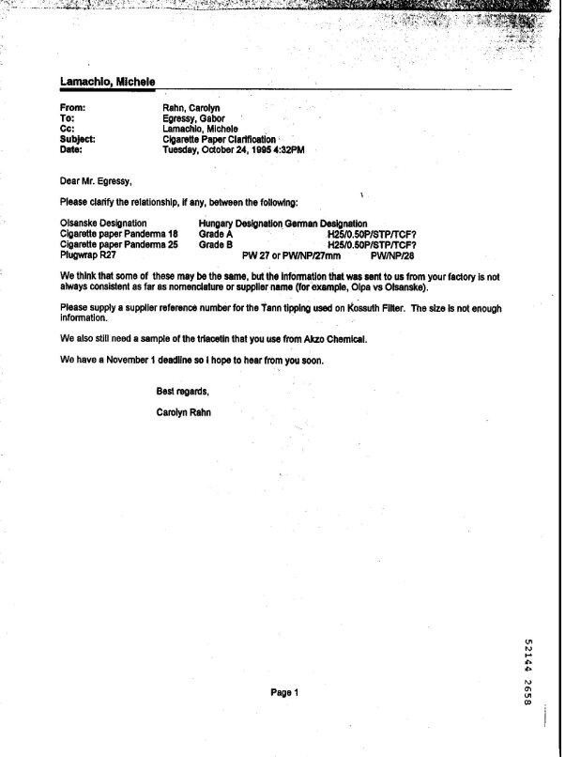
Email

Slide 31
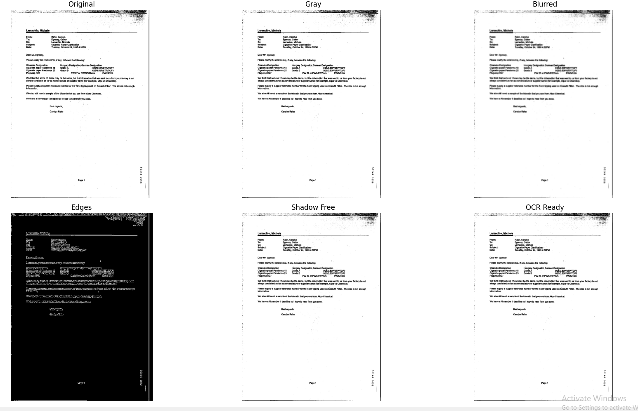
Email

Slide 32
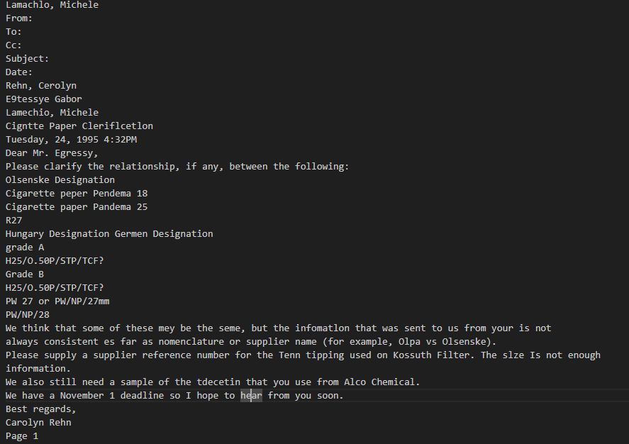
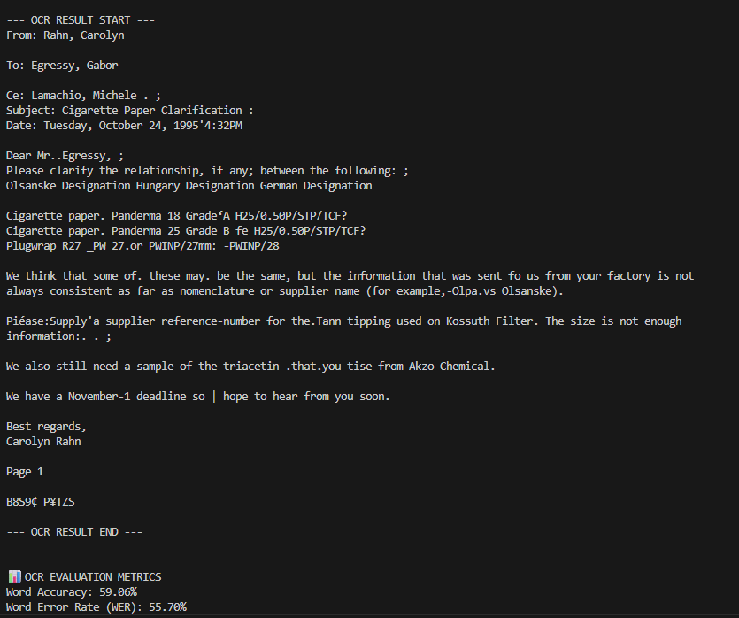

Email: Before enhancement

Slide 33
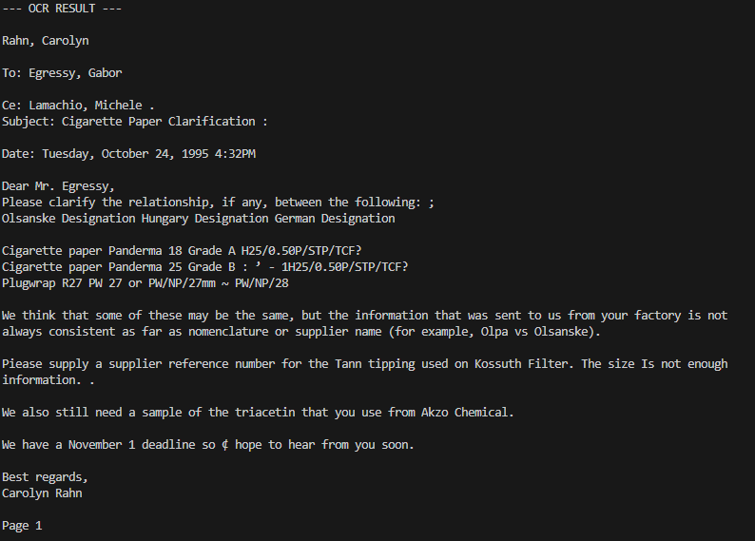

Email: After enhancement

Slide 34
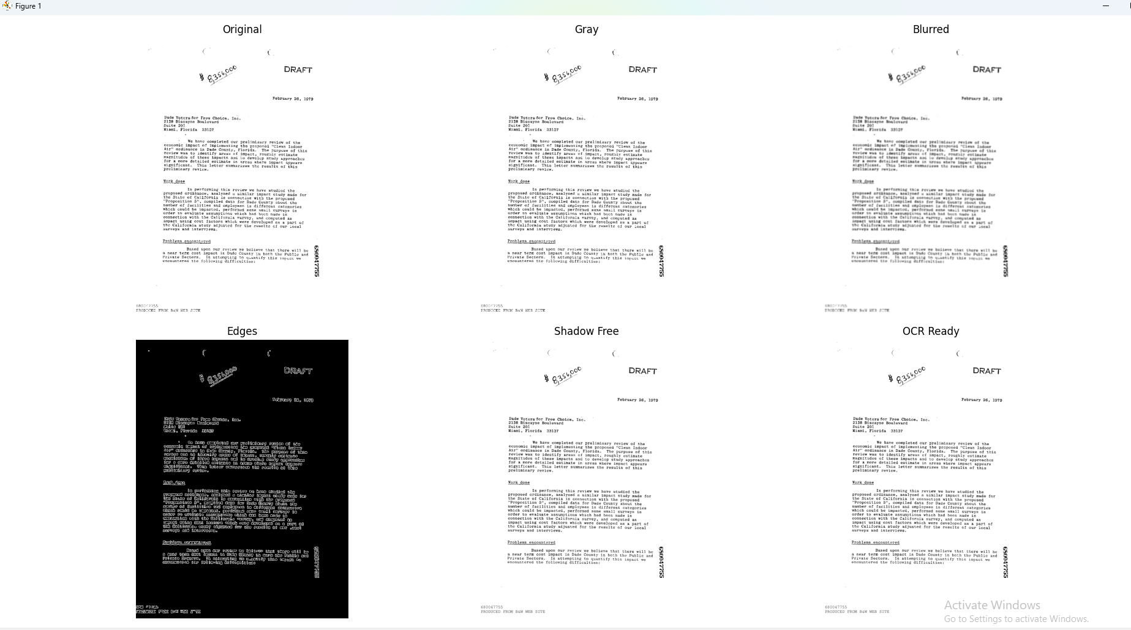
Letter

Slide 35
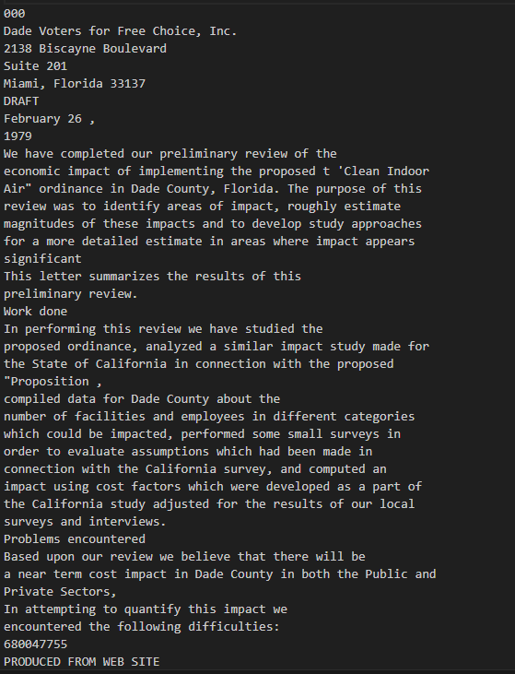
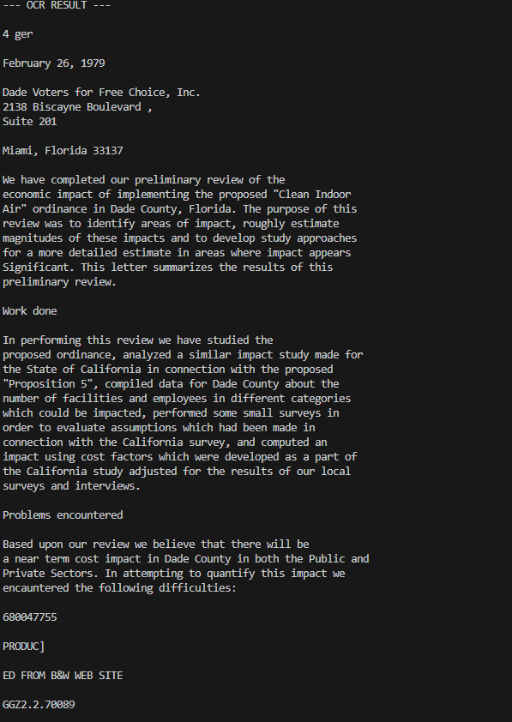

Letter
Ground Truth

Slide 36
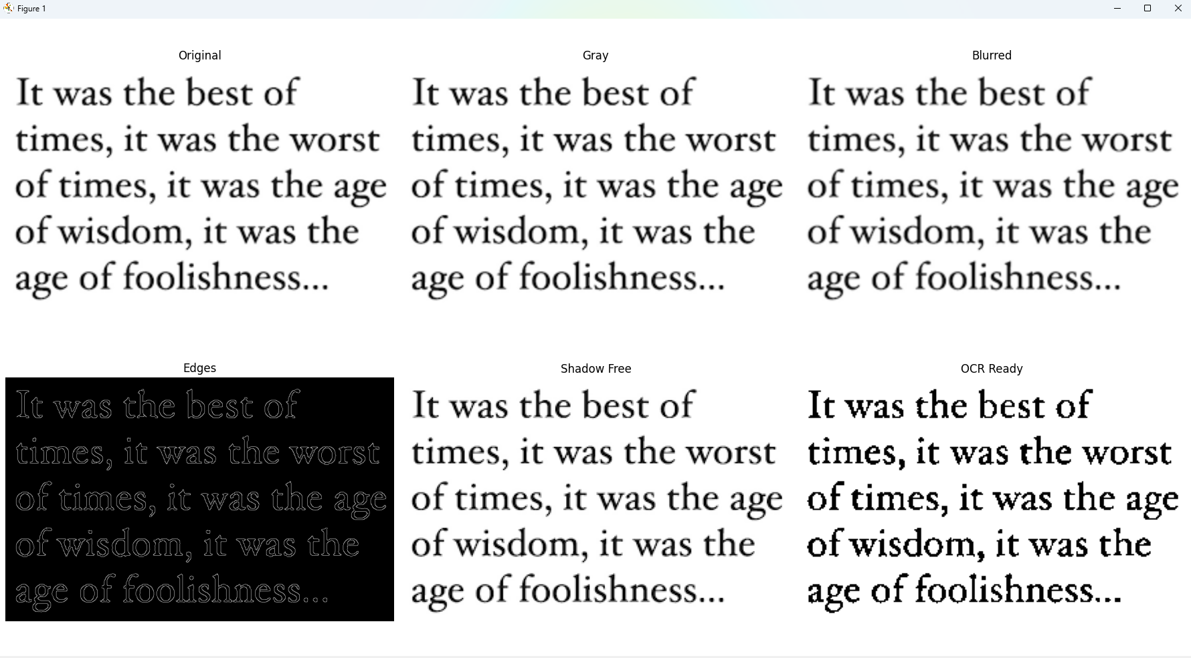
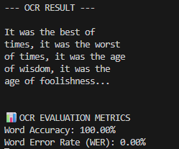
Screenshot

Slide 37
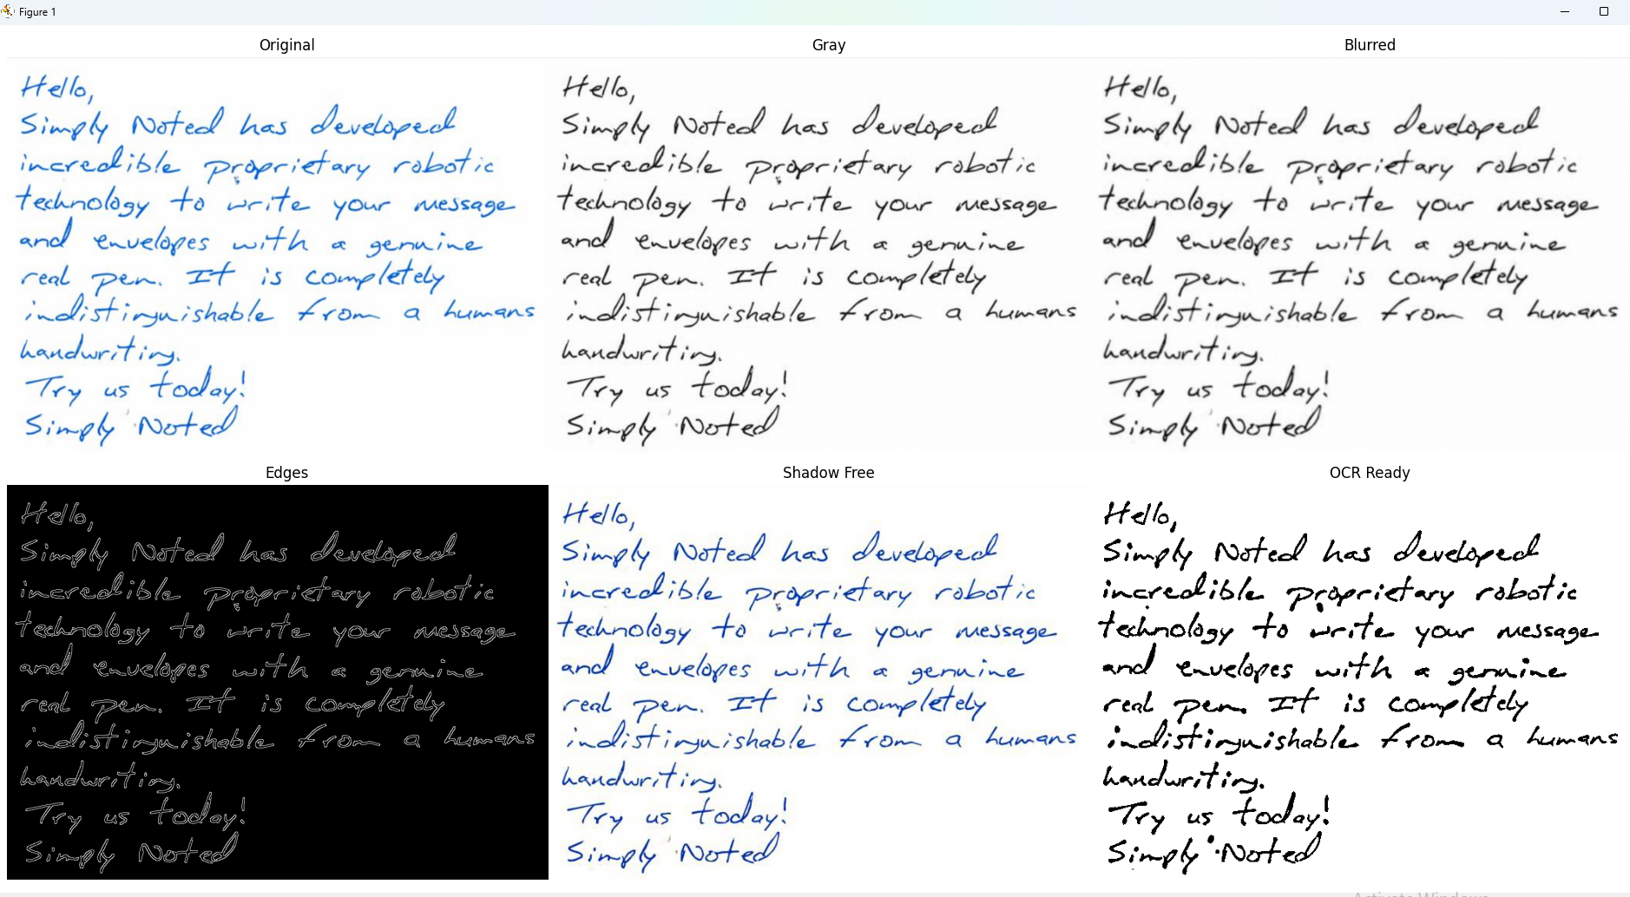

Hand Written

Slide 38
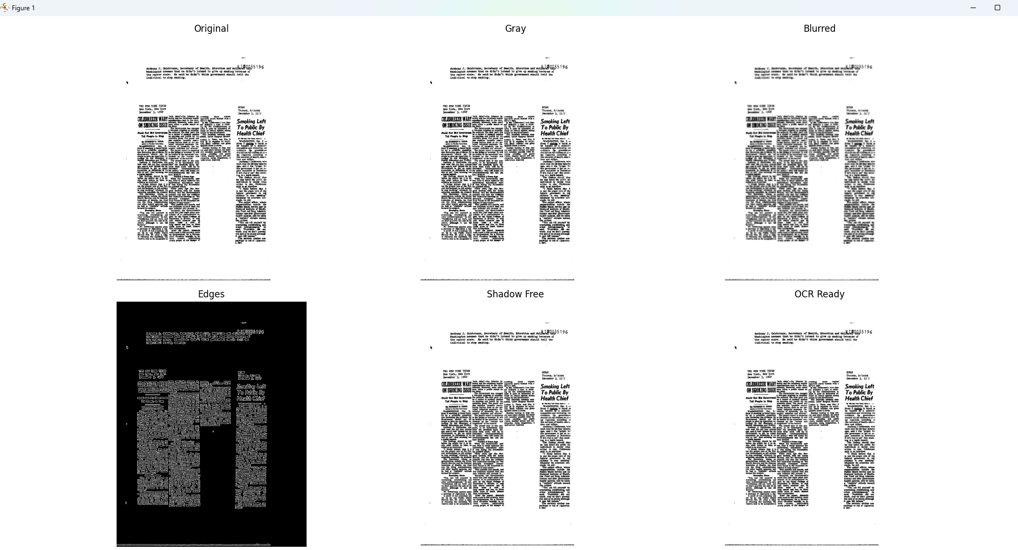

News
One of the weakness point I found for future work

Slide 39
Point of weakness
classic challenge in OCR: it sees the document as a single "block" of text rather than a multi-column layout. When Tesseract reads line-by-line across columns, it mixes sentences together, destroying the meaning of the document.
To solve the weaknesses you identified, we need to implement Layout Analysis (also known as Document AI or Region Segmentation).

Slide 40
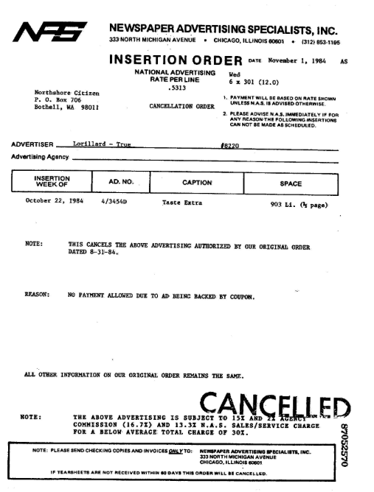
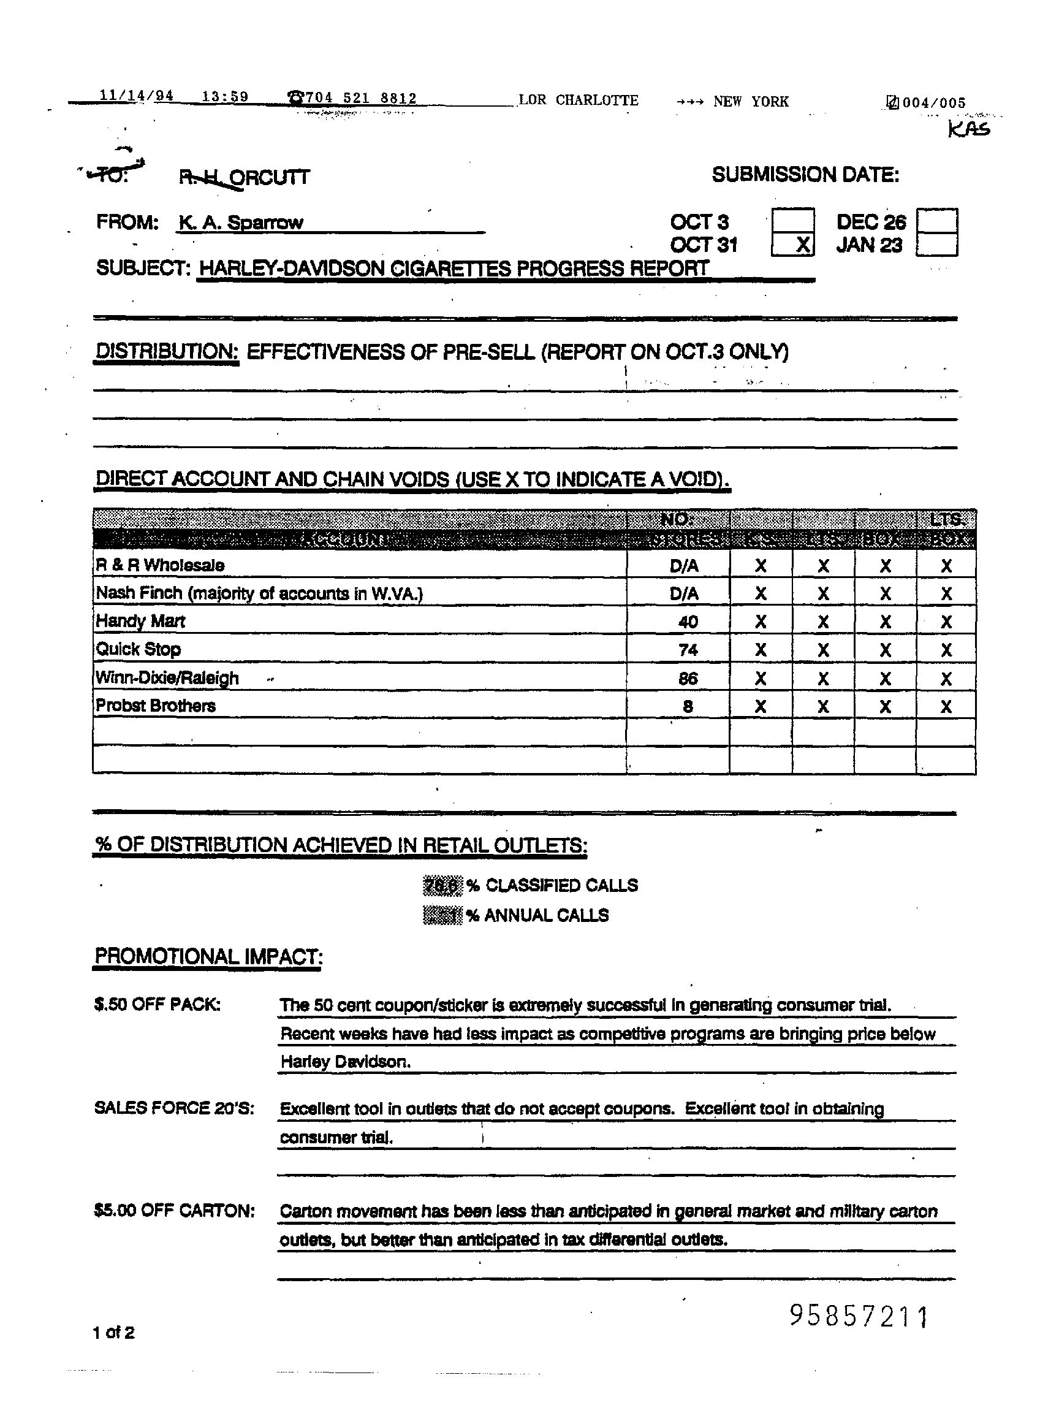
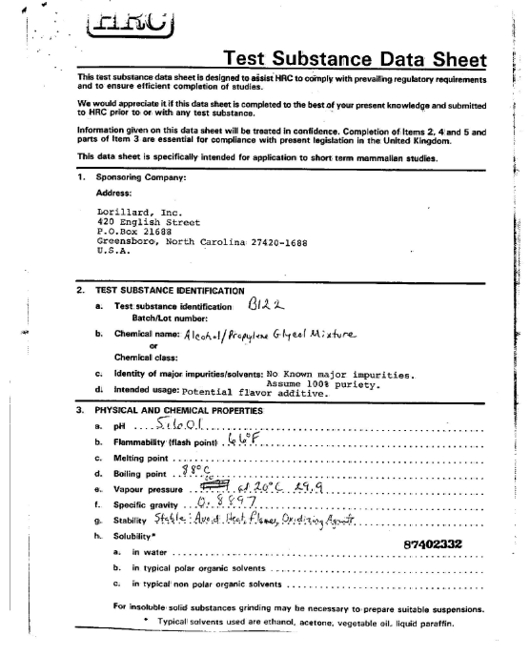
Future Work & Scalability
To move this from a "scanner" to a "document intelligence tool," the following modules are recommended:
Region of Interest (ROI) Detection: Integrating a deep-learning layout analyzer to identify columns, headers, and images separately.
Handwriting Specialization: Swapping the general Tesseract engine for a model trained specifically on cursive and handwritten scripts for medical or archival forms.

Slide 41
Thank you

